Slide 1
UNIT -2
How SDN Works- Fundamental Characteristics of SDN, SDN Operation, SDN Devices
Ref. 1, Ch.4.1, 4.2, 4.3

Slide 2
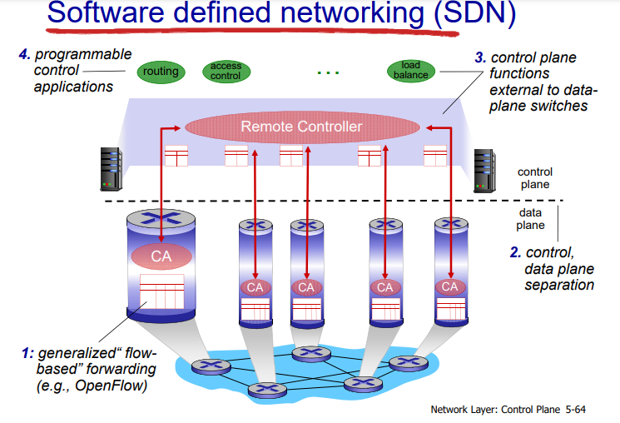
How SDN Works-1.Fundamental Characteristics of SDN
.
Five fundamental traits: plane separation, a simplified device, centralized control, network automation and virtualization, and openness.
1.Plane Separation:
Control Plane: Manages the network by making decisions about where traffic should be sent. This plane is centralized in SDN and typically resides in an SDN controller.
Data Plane: Forwards traffic based on the decisions made by the control plane. It resides in network devices like switches and routers
2.Simple Device and Centralized Control
SDN uses a centralized controller to manage the entire network, providing a global view and enabling more effective and simplified network management and configuration.
The controller communicates with network devices using standardized protocols like OpenFlow.

Slide 3
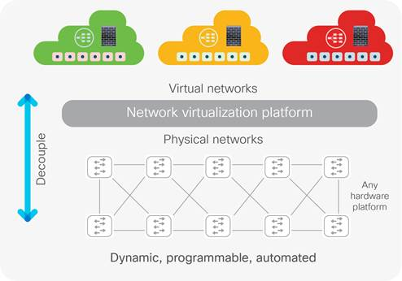
3. Network Automation
SDN supports automation of routine network tasks such as configuration, provisioning, and monitoring, reducing the need for manual intervention and minimizing errors.
The centralized software-based controller in SDN provides an open interface on the controller to allow for automated control of the network. In the context of Open SDN, the terms northbound and southbound are often used to distinguish whether the interface is to the applications or to the devices.
https://www.youtube.com/watch?v=jJ8J0QVnBw8

Slide 4
3. Virtualization:
These terms derive from the fact that in most diagrams the applications are depicted above (i.e., to thenorth of ) the controller, whereas devices are depicted below (i.e., to the south of ) the controller.
The southbound API is the OpenFlow interface that the controller uses to program the network devices. The controller offers a northbound API, allowing software applications to be plugged into the controller and thereby allowing that software to provide the algorithms and protocols that can run the network efficiently.
The northbound API of the controller is intended to provide an abstraction of the network devices and topology..
This level of abstraction provides the ability to virtualize the network, decoupling the network service from the underlying physical network. Those services are still presented to host devices in such a way that those hosts are unaware that the network resources they are using are virtual and not the physical ones for which they were originally designed.
https://www.youtube.com/watch?v=Aaq0WY-LplY
https://www.youtube.com/watch?v=4EavvBUHI9g

Slide 5
4. Scalability: SDN architectures are designed to be highly scalable, supporting large and complex networks by simplifying network management and enabling more efficient use of resources.
5. Openness:
A characteristic of Open SDN is that its interfaces should remain standard, well documented, and not proprietary. The APIs that are defined should give software sufficient control to experiment with and control various control plane options.
keeping open both the northbound and southbound interfaces to the SDN controller will allow for research into new and innovative methods of network operation.(faster technological advancement)
In addition to facilitating research and experimentation, open interfaces permit equipment from different vendors to interoperate. This normally produces a competitive environment which lowers costs to consumers of network equipment. This reduction in network equipment costs has been part of the SDN agenda since its inception.

Slide 6
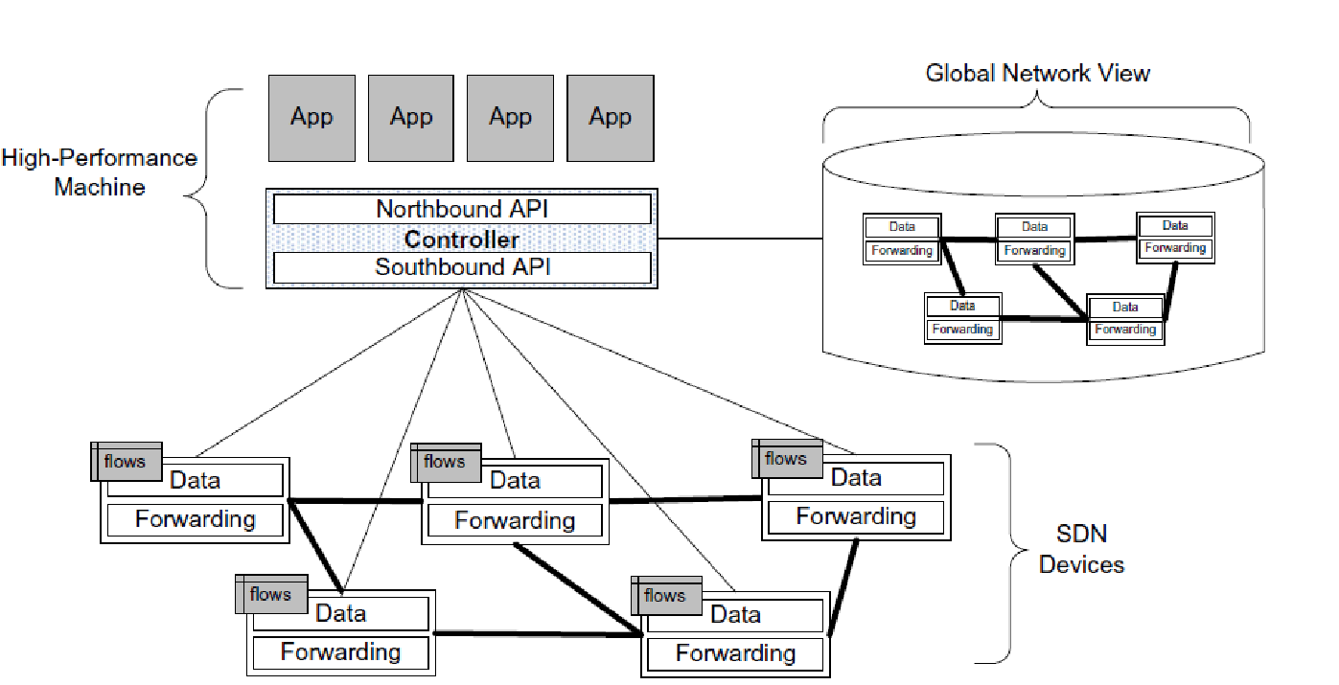
2.SDN Operation
Basic components of SDN:
SDN devices, the controller, and the applications.
the SDN devices contain forwarding functionality for deciding what to do with each incoming packet. The devices also contain the data that drives those forwarding decisions.
The data itself is actually represented by the flows defined by the controller, as depicted in the upper-left portion of each device.
A flow describes a set of packets transferred from one network endpoint (or set of endpoints) to another endpoint (or set of endpoints).
The endpoints may be defined as IP address-TCP/UDP port pairs, VLAN endpoints, layer three tunnel endpoints, and input ports, among other things
https://www.youtube.com/watch?v=9g_f78HaJKg

Slide 7
2.1Flows
In Software-Defined Networking (SDN), "flows" are fundamental to how the network operates. An SDN flow represents a set of packets that are handled in the same way by the network devices. Flows are defined by the SDN controller, which installs flow rules on the network devices (typically switches) to manage how packets are forwarded.
Flows are represented on a device as a flow entry. Each flow entry consists of match criteria, actions, and counters.
A flow table resides on the network device and consists of a series of flow entries and the actions to perform when a packet matching that flow arrives at the device. When the SDN device receives a packet, it accesses its flow tables in search of a match.

Slide 8
2.2.The SDN controller and applications
It centralizes the control plane and provides a global view of the network, making it possible to manage and configure the network dynamically and programmatically.
The controller allows the SDN application to define flows on devices and to help the application respond to packets that are forwarded to the controller by the SDN devices.
In Figure,we see on the right side of the controller that it maintains a view of the entire network that it controls. This permits it to calculate optimal forwarding solutions for the network in a deterministic, predictable manner.
Since one controller can control a large number of network devices, these calculations are normally performed on a high-performance machine. controller might be implemented on an eight-core, 2-GHz CPU versus the single-core, 1-GHz CPU that is more typical on a switch.
SDN applications are built on top of the controller. Since SDN applications are really part of network layers two and three,

Slide 9
Proactive and reactive flows
the concepts of proactive and reactive flows refer to how flow entries (rules for handling packets) are installed in network devices such as switches. These approaches determine when and how the flow entries are set up,
Proactive flow setup involves pre-installing flow entries in the switches before any packets that match these flows arrive. The SDN controller predicts or knows the likely traffic patterns and preconfigures the network devices accordingly.
The SDN application interfaces with the controller, using it to set proactive flows on the devices and to receive packets that have been forwarded to the controller.
Proactive flows are established by the application; typically the application will set these flows when the application starts up, and the flows will persist until some configuration change is made. This kind of proactive flow is known as a static flow.
https://www.youtube.com/watch?v=cXtCENHfyaY

Slide 10
Proactive and reactive flows
Reactive flow setup involves installing flow entries on-demand, as packets arrive at the switch without a matching flow entry. When the first packet of a new flow reaches a switch, it is forwarded to the SDN controller. The controller then determines the appropriate actions and installs the necessary flow entries in the switch.
For example, the controller can insert flows reactively in response to other data sources such as intrusion detection systems (IDS) or the NetFlow traffic analyzer

Slide 11
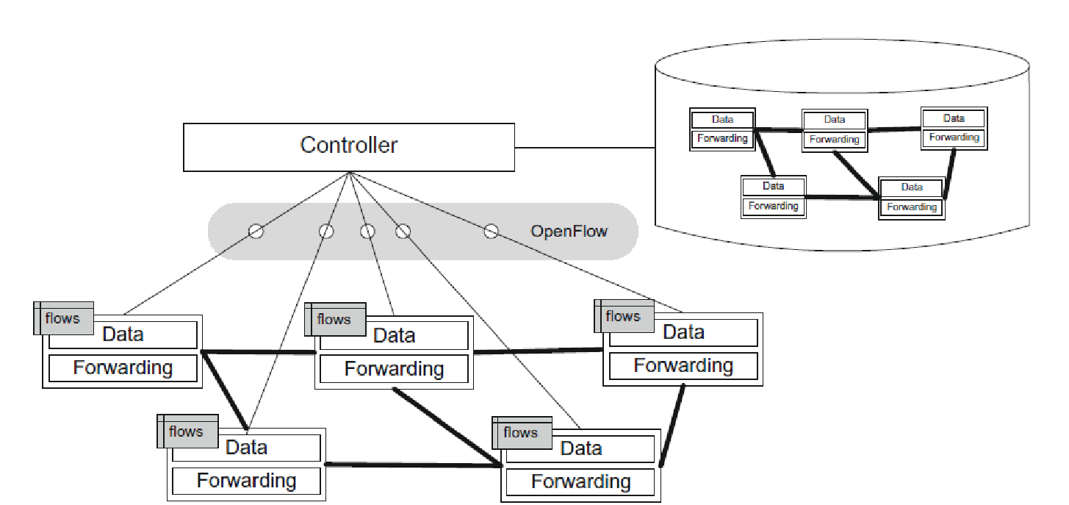
Controller-to-device communication

Slide 12
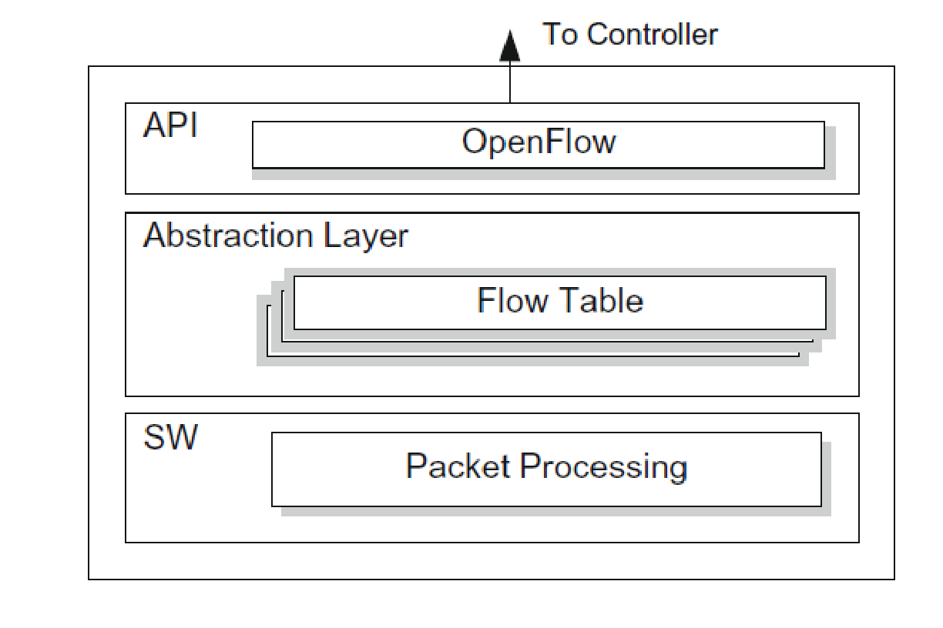
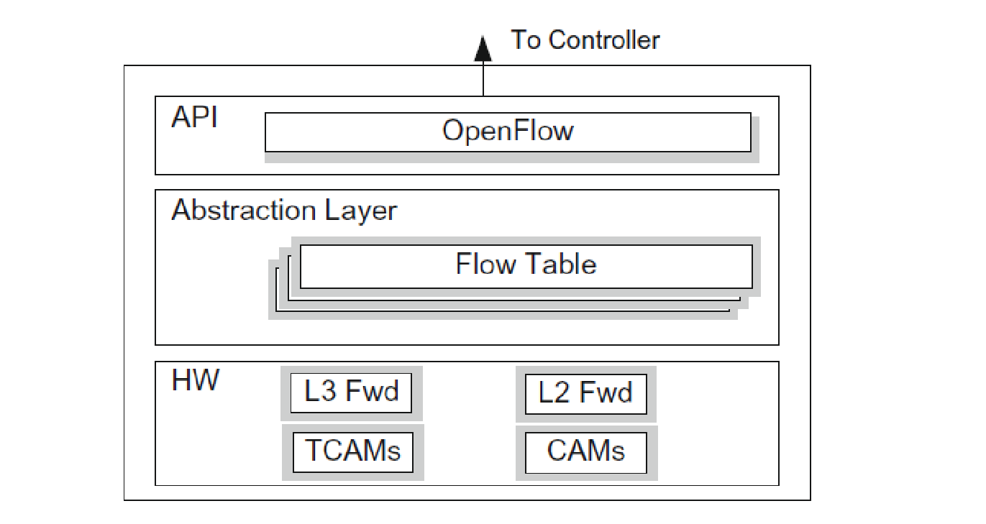
3.SDN Devices
SDN software switch anatomy.
An SDN device is composed of an API for communication with the controller, an abstraction layer, and a packet-processing function.
In the case of a virtual switch, this packet-processing function is packet processing software, as shown in Figure
In the case of a physical switch, the packet-processing function is embodied in the hardware for packet-processing logic, as shown in figure
The abstraction layer expresses one or more flow tables.
The packet-processing logic consists of the mechanisms to take actions based on the results of evaluating incoming packets and finding the highest-priority match. When a match is found, the incoming packet is processed locally unless it is explicitly forwarded to the controller.
When no match is found, the packet may be copied to the controller for further processing. This process is also referred to as the controller consuming the packet
SDN hardware switch anatomy

Slide 13
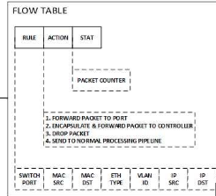
3.1. Flow Tables
Flow tables are the fundamental data structures in an SDN device. These flow tables allow the device to evaluate incoming packets and take the appropriate action based on the contents of the packet that has just been received
Flow tables consist of a number of prioritized flow entries, each of which typically consists of two components: match fields and actions. Match fields are used to compare against incoming packets. An incoming packet is compared against the match fields in priority order, and the first complete match is selected.
https://www.youtube.com/watch?v=cxR6MbY7djs

Slide 14
3.2.SDN Software Switches
Implementation of SDN devices in software is the simplest means of creating an SDN device, because the flow tables, flow entries, and match fields involved are easily mapped to general software data structures, such as sorted arrays and hash tables.
Conversely, implementations in software are likely to be slower and less efficient than those implemented in hardware
Software device implementations also suffer less from resource constraints, since considerations such as processing power and memory size are not an issue in typical implementations. Thus, whereas a hardware SDN device implementation will support only a comparatively limited number of flow entries, the ceiling on the number of flow entries on a software device may be orders of magnitude larger.
As software device implementations have more flexibility to implement more complex actions,

Slide 15
3.3.Hardware switch of SDN Devices
This hardware includes the layer two and layer three forwarding tables, usually implemented using content-addressable memories (CAMs) and ternary content-addressable memories (TCAMs) The layer two forwarding table is typically implemented using regular CAM or hardware-based hashing. These kinds of associative emeries are used when there are precise indices, such as a 48-bit MAC address
This hardware functionality allows the device to both match packets and then take actions at a very high rate. However, it also presents a series of challenges to the SDN device developer. Specifically:
Obviously, hardware will handle the flow lookups much faster than software, but hardware tables have limitations on the number of flow entries they can hold at any time, and software tables could be used to handle the overflow.

Slide 16
3.4.Existing SDN Device Implementations
Open vSwitch (OVS) [4] from Nicira and Indigo [5] from Big Switch. Incumbent network equipment manufacturers (NEMs), such as Cisco, HP, NEC, IBM, Juniper, and Extreme, have added OpenFlow support to some of their legacy switches.
There is also a new class of devices called white-box switches,

Slide 17
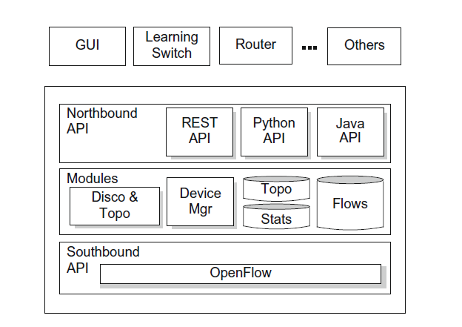
4.SDN Controller
The southbound API is used to interface with the SDN devices. This API is OpenFlow in the case of Open SDN or some proprietary alternative in other SDN solutions.
OpenFlow’s companion protocol, OF-Config and Nicira’s Open vSwitch Database Management Protocol (OVSDB) are both open protocols for the southbound interface, though these are limited to configuration roles.
there is currently no northbound counterpart to the southbound OpenFlow standard or even the de facto legacy standards
Some avilable nothbound interfaces are the Floodlight controller [2] includes a Java API and a Representational State Transfer (RESTful) API. The OpenDaylight controller provides a RESTful API for applications running on separate machines.
SDN controller anatomy.

Slide 18
4.1.SDN Controller Core Modules
Every controller provides core functionality between these raw interfaces. Core features in the controller include:
• End-user device discovery. Discovery of end-user devices such as laptops, desktops, printers,mobile devices, and so on.
• Network device discovery. Discovery of network devices that comprise the infrastructure of the network, such as switches, routers, and wireless access points.
• Network device topology management. Maintain information about the interconnection details of the network devices to each other and to the end-user devices to which they are directly attached.
• Flow management. Maintain a database of the flows being managed by the controller and perform all necessary coordination with the devices to ensure synchronization of the device flow entries with that database.

Slide 19
4.3.Existing SDN Controller Implementations
Open source SDN controllers :come in many forms, from basic C-language controllers such as NOX[7] to Java-based versions such as Beacon [1] and Floodlight [2]. There is even a Ruby-based [8] controller called Trema [9].
Interfaces to these controllers may be offered in the language in which the controller is written or other alternatives, such as REST or Python.

Slide 20
5.SDN Applications
Through this API the applications are able to
(1) configure the flows to route packets through the best path between two endpoints;
(2) balance traffic loads across multiple paths or destined to a set of endpoints;
(3) react to changes in the network topology such as link failures and the addition of new devices and paths, and
(4) redirect traffic for purposes of inspection, authentication,
some standard applications, such as a graphical user interface (GUI) for managing the controller, a learning switch, and a routing application, load balancing, firewalling, or some other

Slide 21
6.Alternate SDN Methods
We define here two alternate categories of SDN implementations: SDN via existing APIs and SDN via hypervisor-based overlay networks
The first of these consists of employing functions that exist on networking devices that can be invoked remotely, typically via traditional methods such as SNMP or CLI or by the newer, more flexible mechanisms provided by RESTful APIs.
In SDN via hypervisor based overlay networks, the details of the underlying network infrastructure are not relevant. Virtualized overlay networks are instantiated across the top of the physical network. One early example of this sort of network virtualization is VLAN technology, P2P/overlay network, such as Napster and BitTorrent.

Slide 22
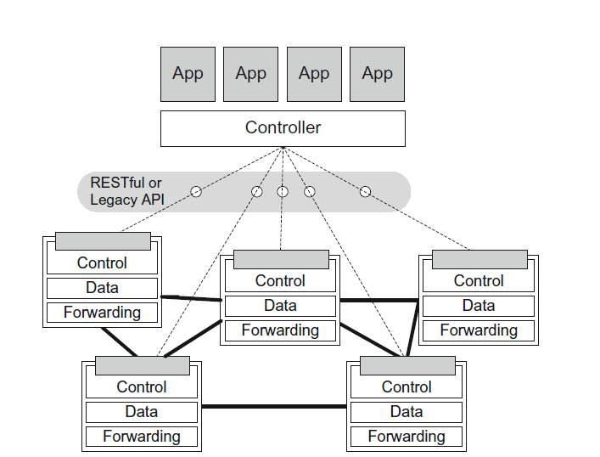
6.1.SDN via Existing APIs
controller communicating with devices via a registered API. Often with SDN via existing APIs solutions, vendors provide an enhanced level of APIs on their devices,
.
The most common of these is the RESTful API. REST has become the dominant method of making API calls across networks.
REST uses HyperText Transfer Protocol (HTTP), the protocol commonly used to pass web traffic.

Slide 23
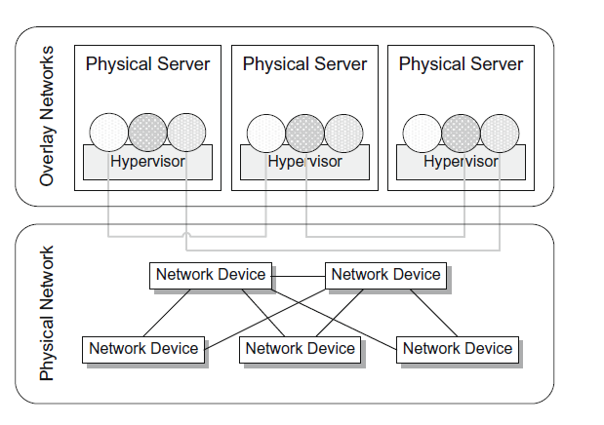
6.2.SDN via Hypervisor-Based Overlay Networks
virtualized networks overlaying the physical network infrastructure
The SDN applications making use of these overlay network resources virtual network traffic runs above the physical network infrastructure. The hypervisors inject traffic into the virtual network and receive traffic from it.
The traffic of the virtual networks is passed through those physical devices, but the endpoints are unaware of the details of the physical topology, the way routing occurs, or other basic network functions
Virtualized networks.

Slide 24
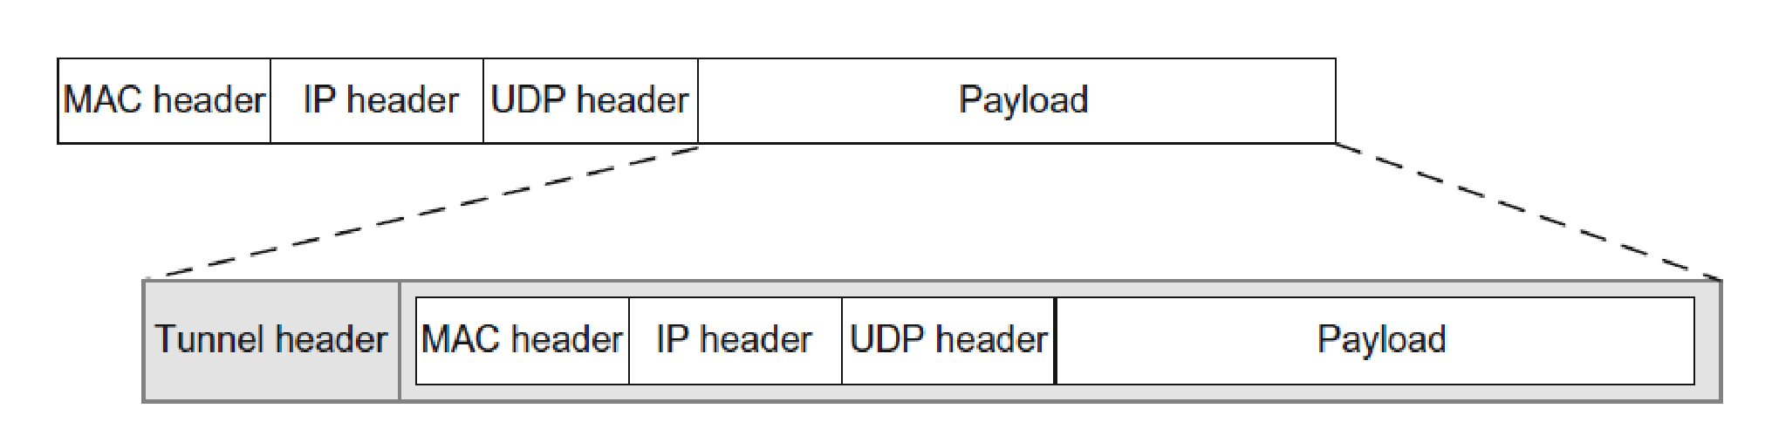
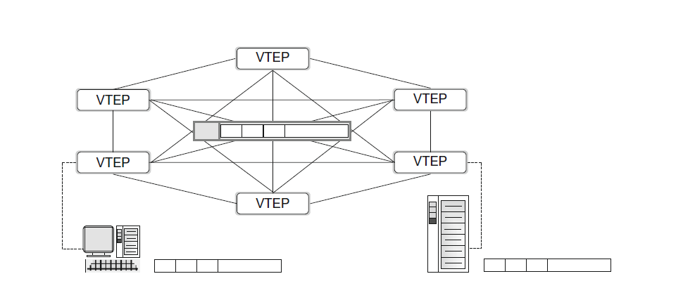
The mechanism that makes this possible is tunnelling, which uses encapsulation.
When a packet enters the edge of the virtual network at the source, the networking device (usually the hypervisor) will take the packet in its entirety and encapsulate it within another frame. This is shown in Figure 4.9. Note that the edge of the virtual network is called a tunnel endpoint or virtual tunnel endpoint (VTEP).
The hypervisor then takes this encapsulated packet and, based on information programmed by the controller, sends it to the destination’s VTEP. This VTEP decapsulates the packet and forwards it to the destination host.
As the encapsulated packet is sent across the physical infrastructure, it is being sent from the source’s VTEP to the destination’s VTEP
This tunnelling mechanism is referred to as MAC-in-IP tunnelling because the entire frame, from MAC address inward, is encapsulated within this unicast IP frame
Encapsulated frames

Slide 25
UNIT -2
General Concepts of SDN Controller, Vmware
Ref. 2, Ch.4 (Page. 72 to Page 79)

Slide 26
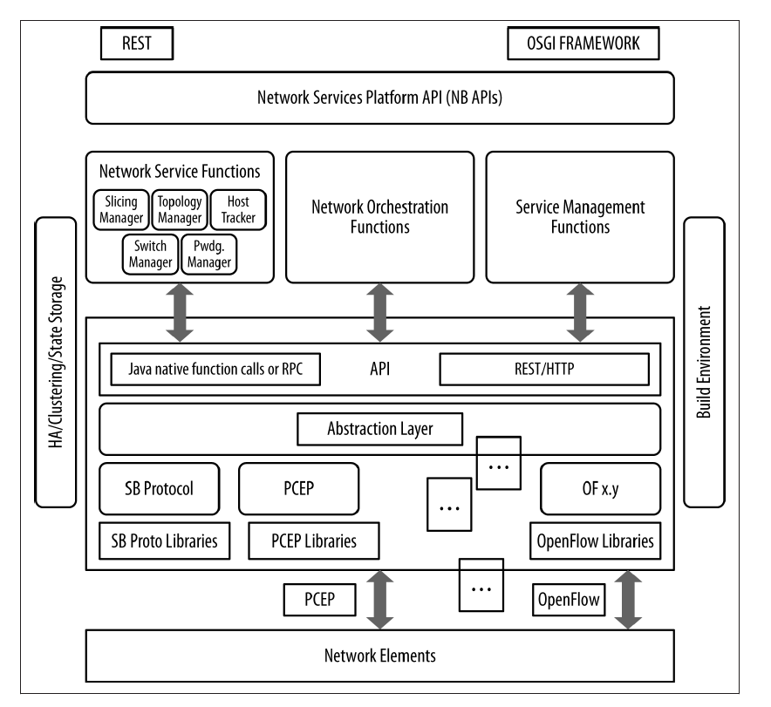
General Concepts of SDN Controller
Idealized controller/framework

Slide 27
The general description of an SDN controller is a software system or collection of systems that together provides:
Management of network state, the management and distribution of this state, may involve a database. These databases serve as a repository for information derived from the controlled network elements
A high-level data model that captures the relationships between managed resources, policies and other services provided by the controller.

Slide 28
A modern, often RESTful (representational state transfer) application programming interface (API) is provided that exposes the controller services to an application.
• A device, topology, and service discovery mechanism; a path computation system; and potentially other network-centric or resource-centric information services
The current landscape of controllers includes the commercial products of Vmware (vCloud/vSphere), Nicira (NVP), NEC (Trema), Big Switch Networks (Floodlight/ BNC), and Juniper/Contrail. It also includes a number of open source controllers

Slide 29
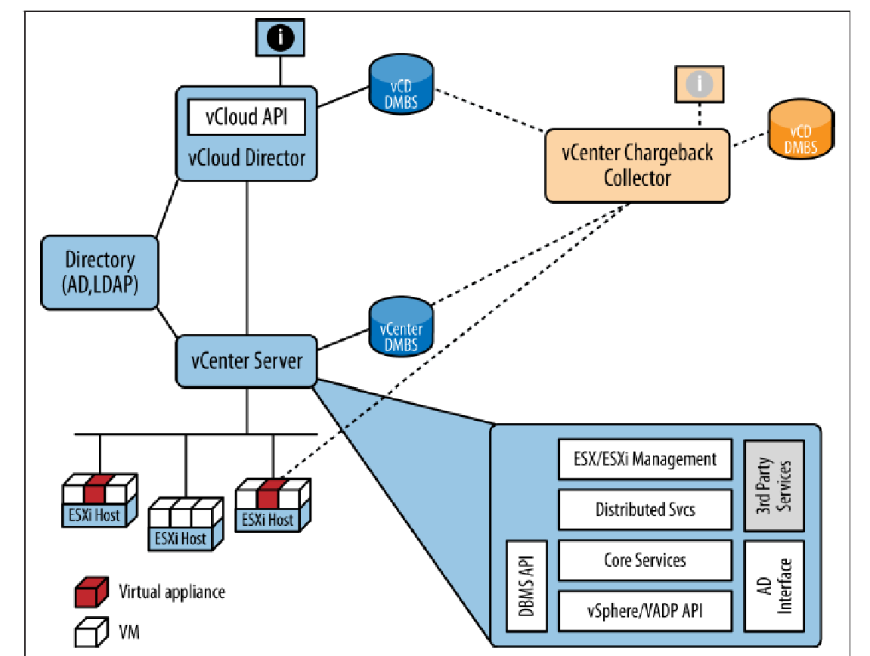
VMware
VMware is a leading provider of virtualization and cloud computing software and services. VMware provides a data center orchestration solution with a registered SDN controller
VMware provides a suite of data-center−centric applications built around the ESX (ESXi for version 5.0 and beyond) hypervisor
VMware vSphere is the flagship product for server virtualization.
vCenter Server: Centralized management platform for vSphere environments, enabling administrators to manage VMs

Slide 30
Suite designed for IaaS applications
Suite designed for IaaS applications, which includes:
vSphere
Manages what is labeled “virtualized infrastructure” by VMware. This includes managing the hypervisor integrated vswitch (from a networking perspective) as well as the other, basic IaaS components—compute, storage, images, and services. The suite uses an SQL Database (Microsoft or Oracle) for resource data storage.
vCloud Director and vCloud Connector
Primary application for compute, storage, image resource management, and public cloud extension.
vCloud Networking and Security
Self-descriptive applications.
vCloud Automation Center
Provisioning assist for IT management.
vCenter Site Recovery Manager
A replication manager for automated disaster recovery.
vCenter Operations Management Suite
Application monitoring, VM host and vSphere configuration and change management, discovery, charging, analytic, and alerting.

Slide 31
Core of VMware solution is Java-centric
In 2011, VMware launched an open source PaaS system called Cloud Foundry,5 which offers a hosted service that runs on VMware.
The core of VMware solution is Java-centric, with the following features:
HTTP REST-based API set oriented in expression toward the management of resources
• Spring-based component framework
• Open Services Gateway Initiative (OSGI) module framework7
• Publish/subscribe message bus based on JMS
• Hibernate DBMS interface (Hibernate is an object/relational mapping library that allows a Java developer to create/retrieve a relational store of objects).

